Slide 1
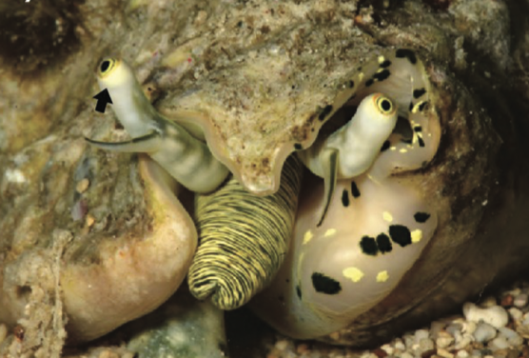
Alison R. Irwin, Nicholas W. Roberts, Ellen E. Strong, Yasunori Kano, Daniel I. Speiser, Elizabeth M. Harper, and Suzanne T. Williams. 2025 “Evolution of Large Eyes in Stromboidea (Gastropoda): Impact of Photic Environment and Life History Traits” Systematic Biology 74(2):301–322, https://doi.org/10.1093/sysbio/syae063
Class focus area: inferring a phylogeny
EEB603: Brian O’Meara
All quotes and images from the above paper unless otherwise noted
Photo by David Massemin

Slide 2
In this study, we:
use specimens from museum collections
to construct a phylogeny comprising a third of all known stromboid species
time-calibrate this tree using data from the rich stromboid fossil record
use ancestral state reconstruction to explore the impact of depth, turbidity, and diel activity on the evolution of eye size and other visual traits, thus identifying some of the key drivers underpinning the great morphological variation in the stromboidean visual systems.

Slide 3
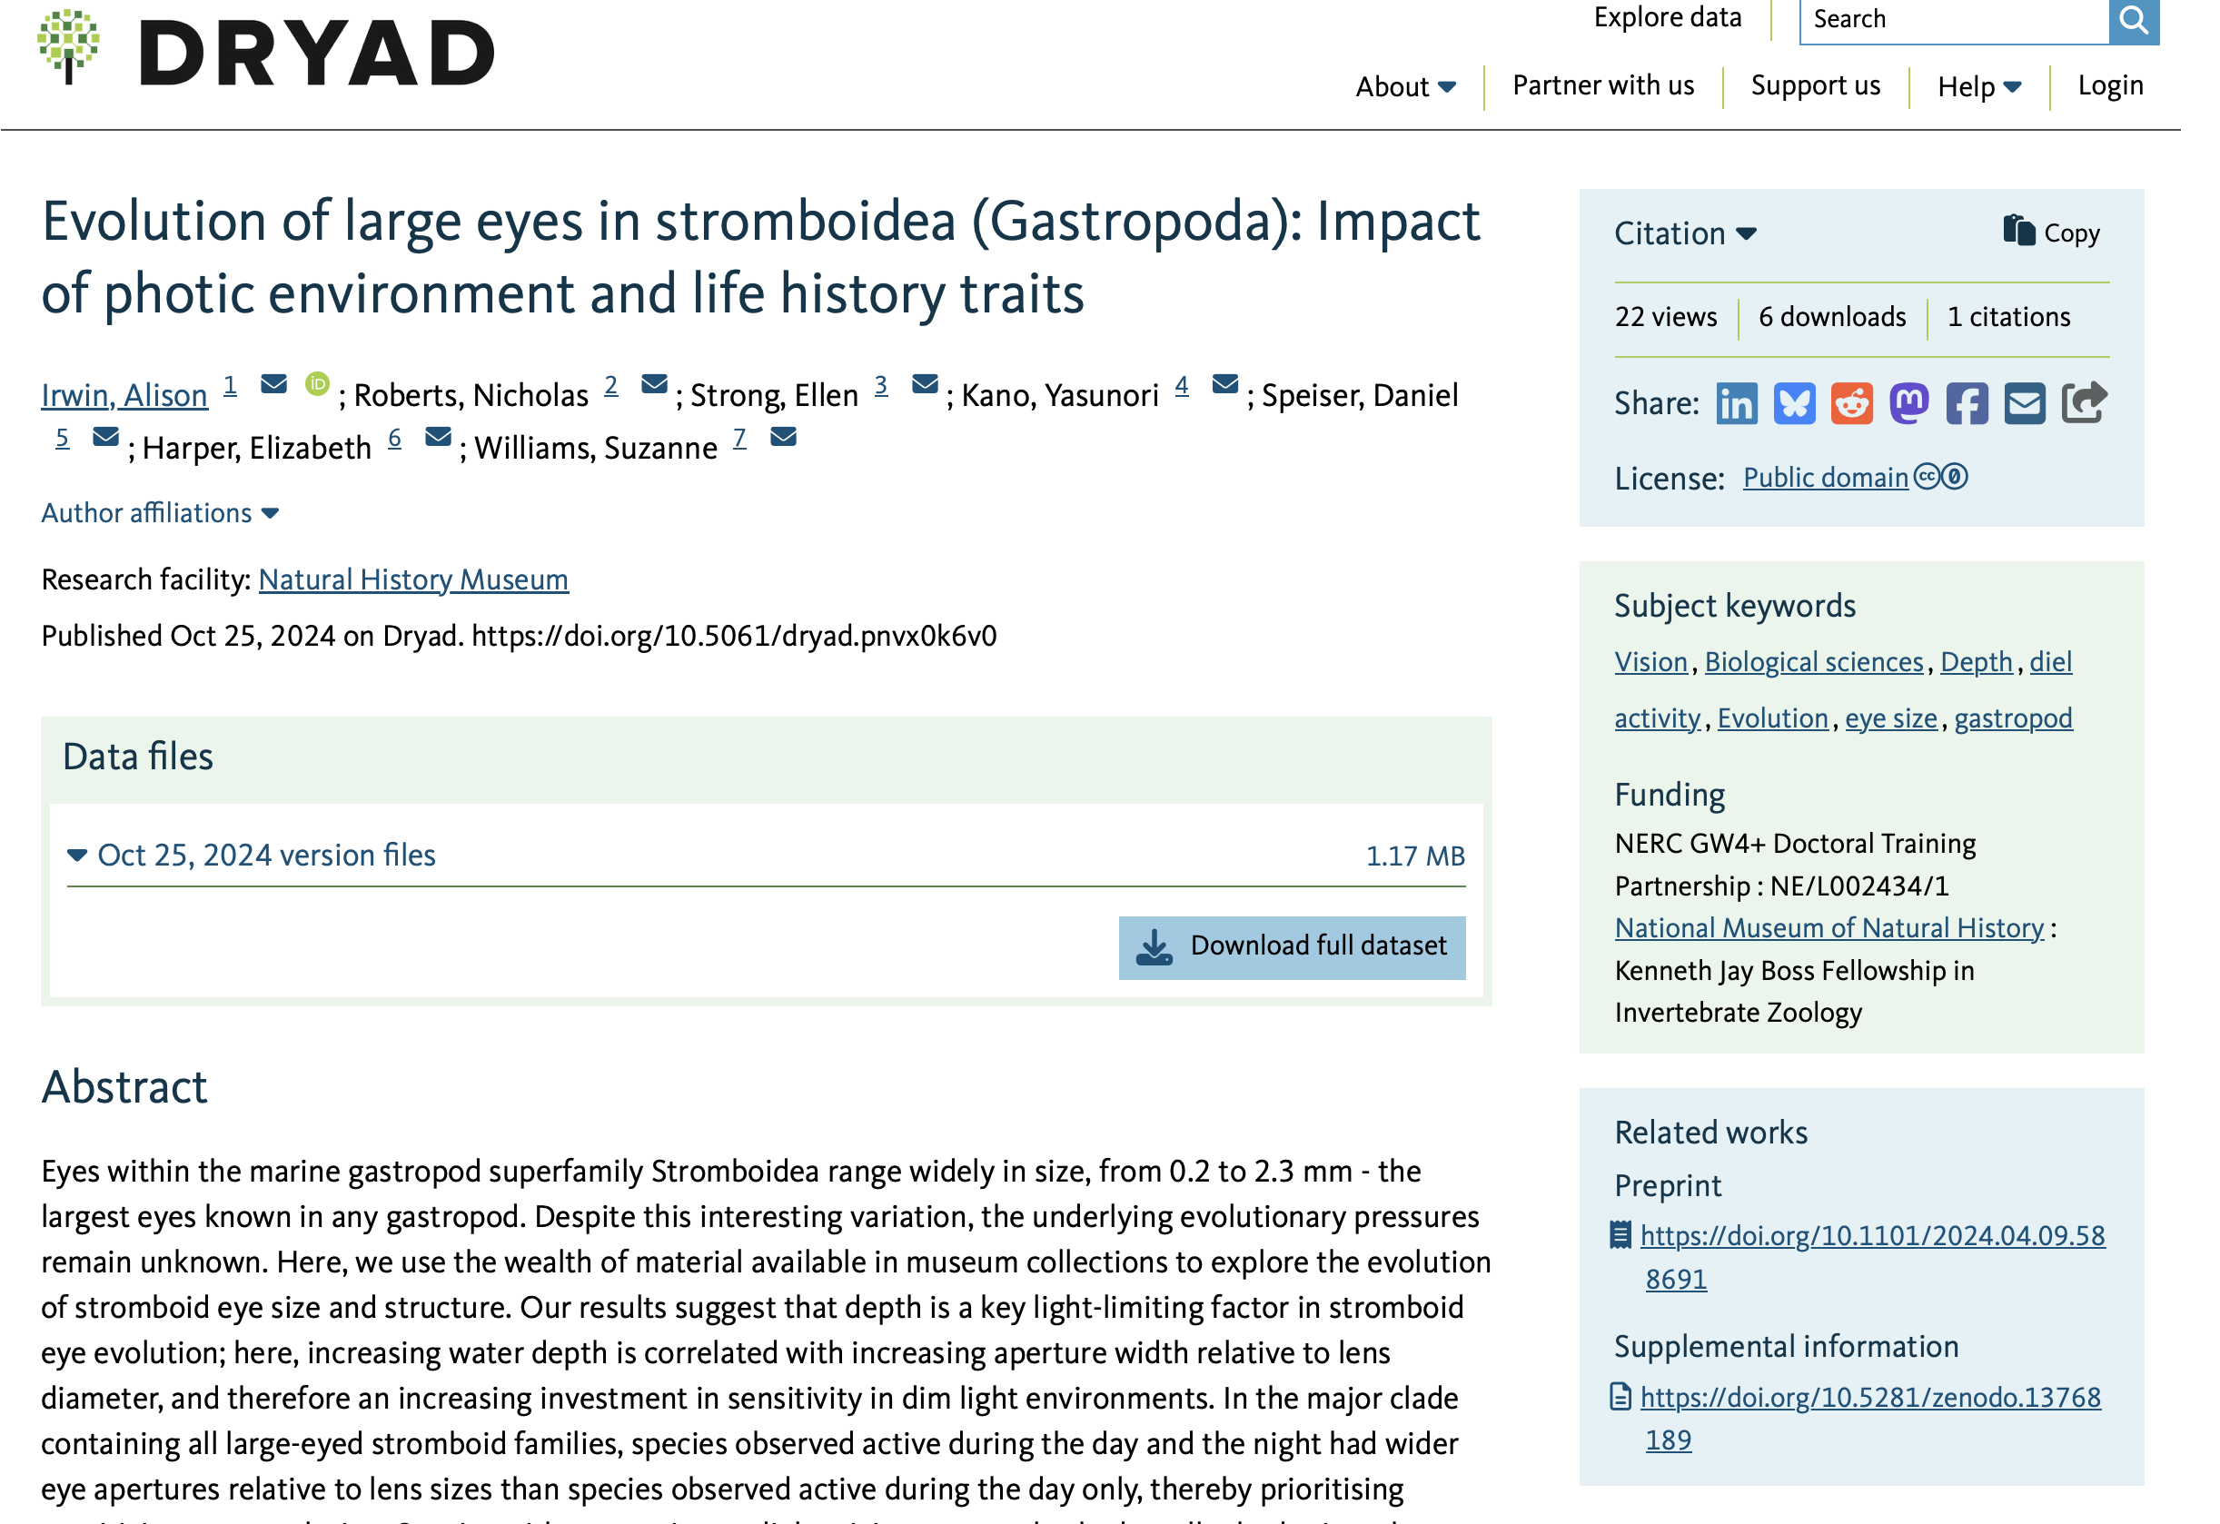
Notes:
The data are available

Slide 4
“Fragments of the nuclear 28S rRNA gene (28S) and 3 mitochondrial genes, cytochrome oxidase subunit I (COI), 16S rRNA (16S), and 12S rRNA (12S), were amplified and sequenced following Williams and Ozawa (2006) (except that most 28S sequences were obtained with a novel forward primer, designed for Stromboidea; Stromb_F, 5ʹ–CAGTAACGGCGAGTGAAGC–3ʹ). These genes were chosen to cover a range of evolutionary rates and have been useful in resolving gastropod relationships across broad taxonomic levels”

Slide 5
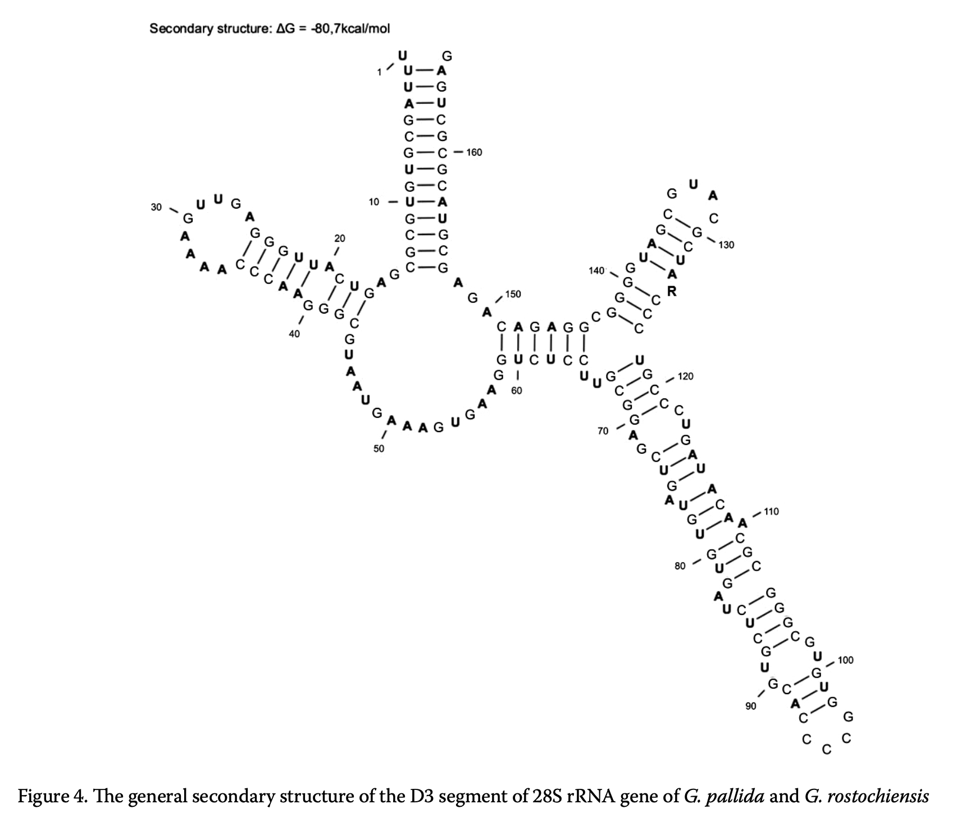
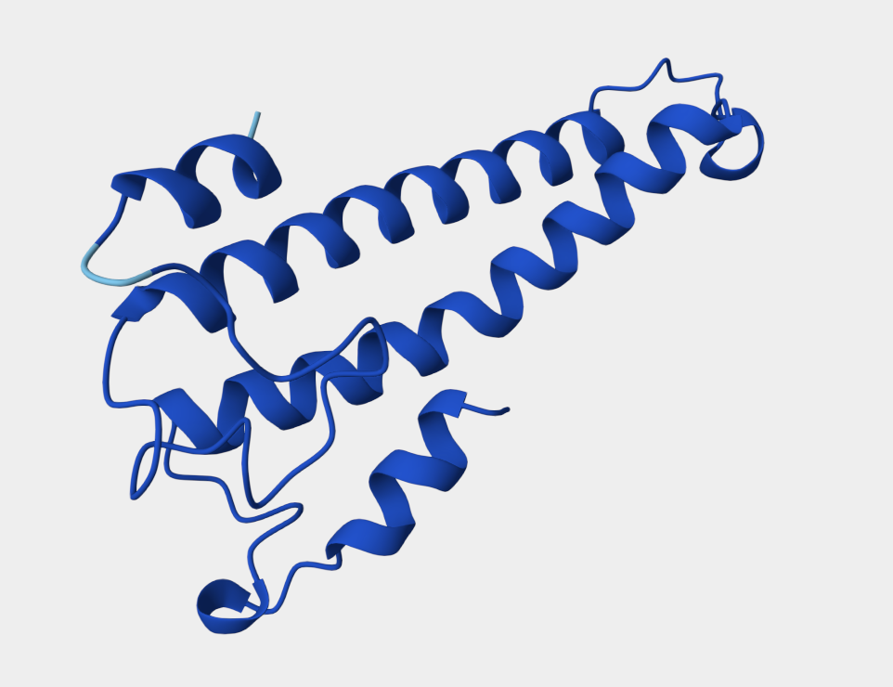
“Fragments of the nuclear 28S rRNA gene (28S) and 3 mitochondrial genes, cytochrome oxidase subunit I (COI), 16S rRNA (16S), and 12S rRNA (12S), were amplified and sequenced following Williams and Ozawa (2006) (except that most 28S sequences were obtained with a novel forward primer, designed for Stromboidea; Stromb_F, 5ʹ–CAGTAACGGCGAGTGAAGC–3ʹ). These genes were chosen to cover a range of evolutionary rates and have been useful in resolving gastropod relationships across broad taxonomic levels”
Figure from Douda et al. 2010
COI diagram from https://www.uniprot.org/uniprotkb/M9Z2G2/feature-viewer
Notes:
28S is ribosomal RNA; COI is a gene that codes for protein.

Slide 6
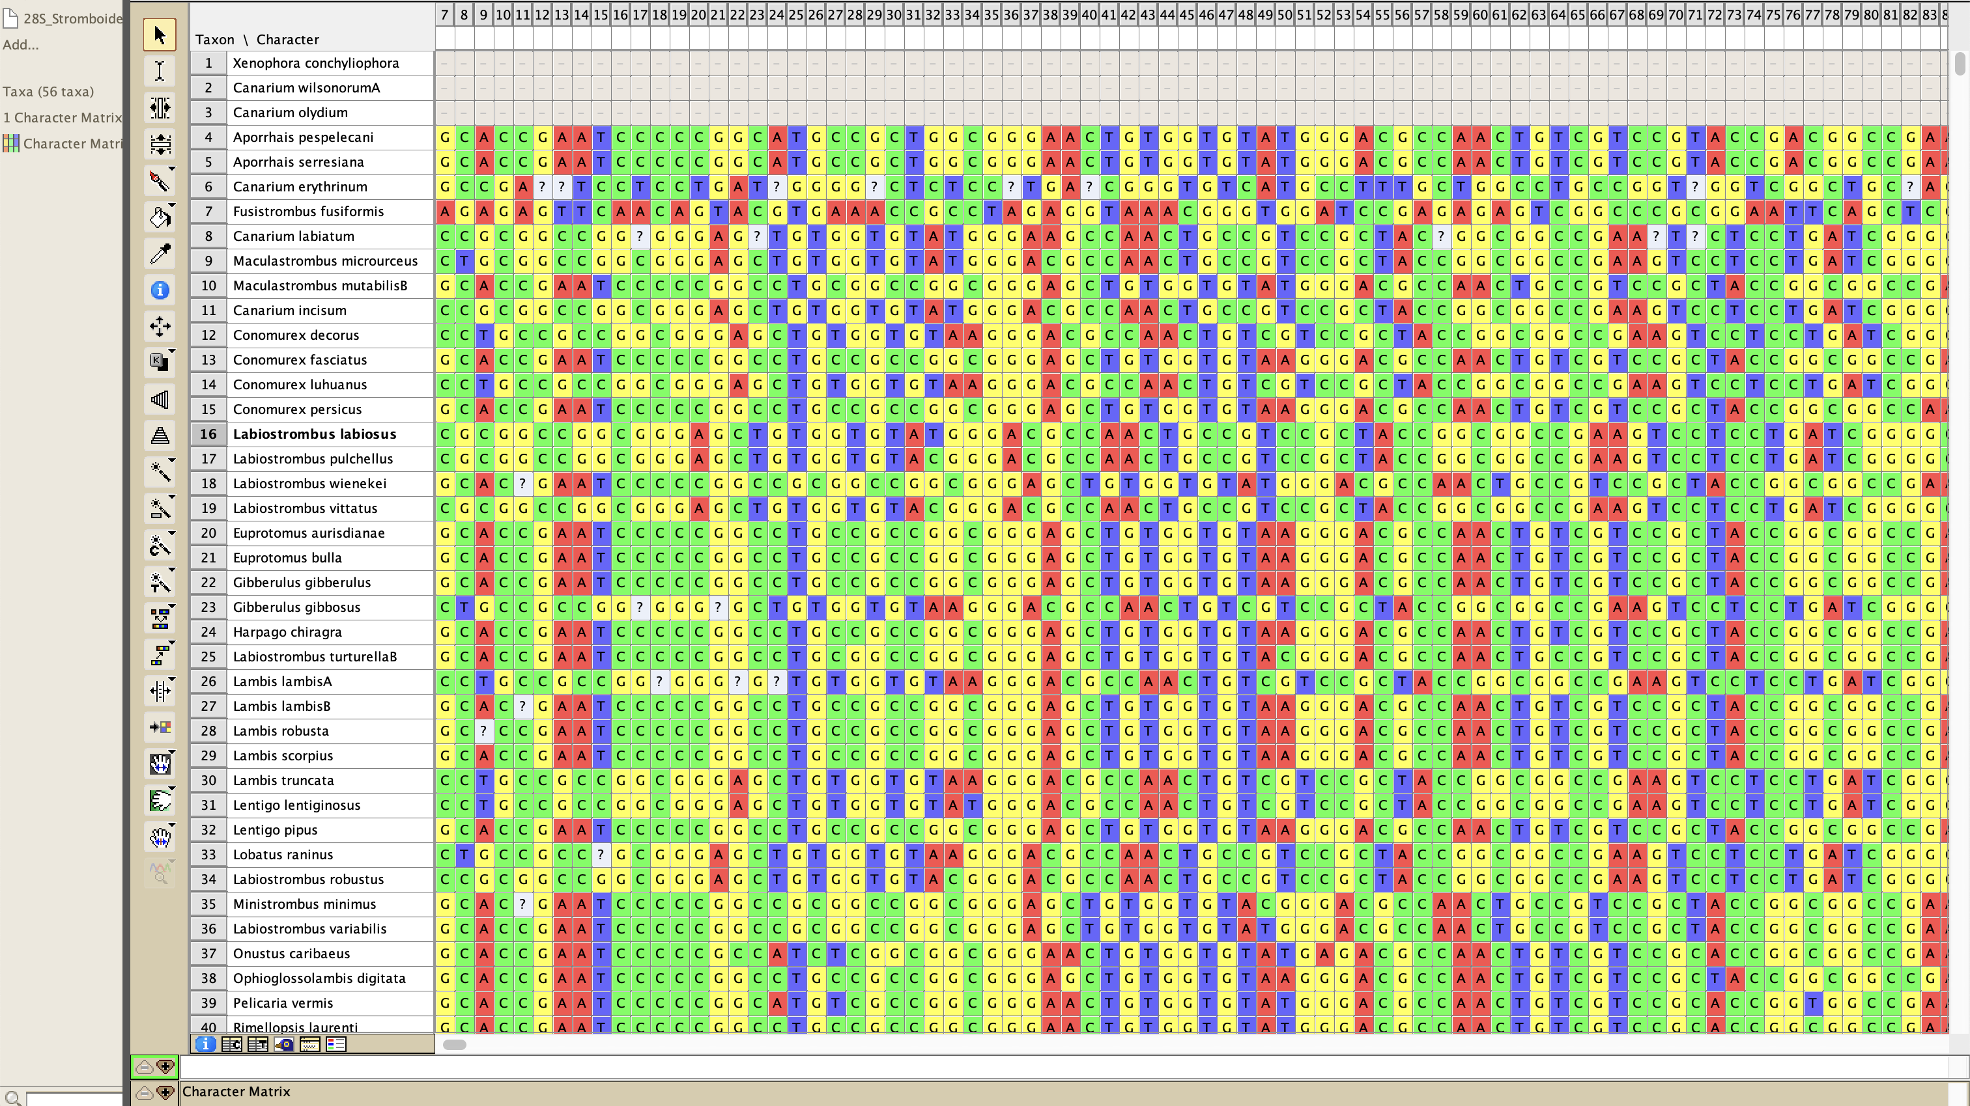
Notes:
Hooray for Mesquite

Slide 7
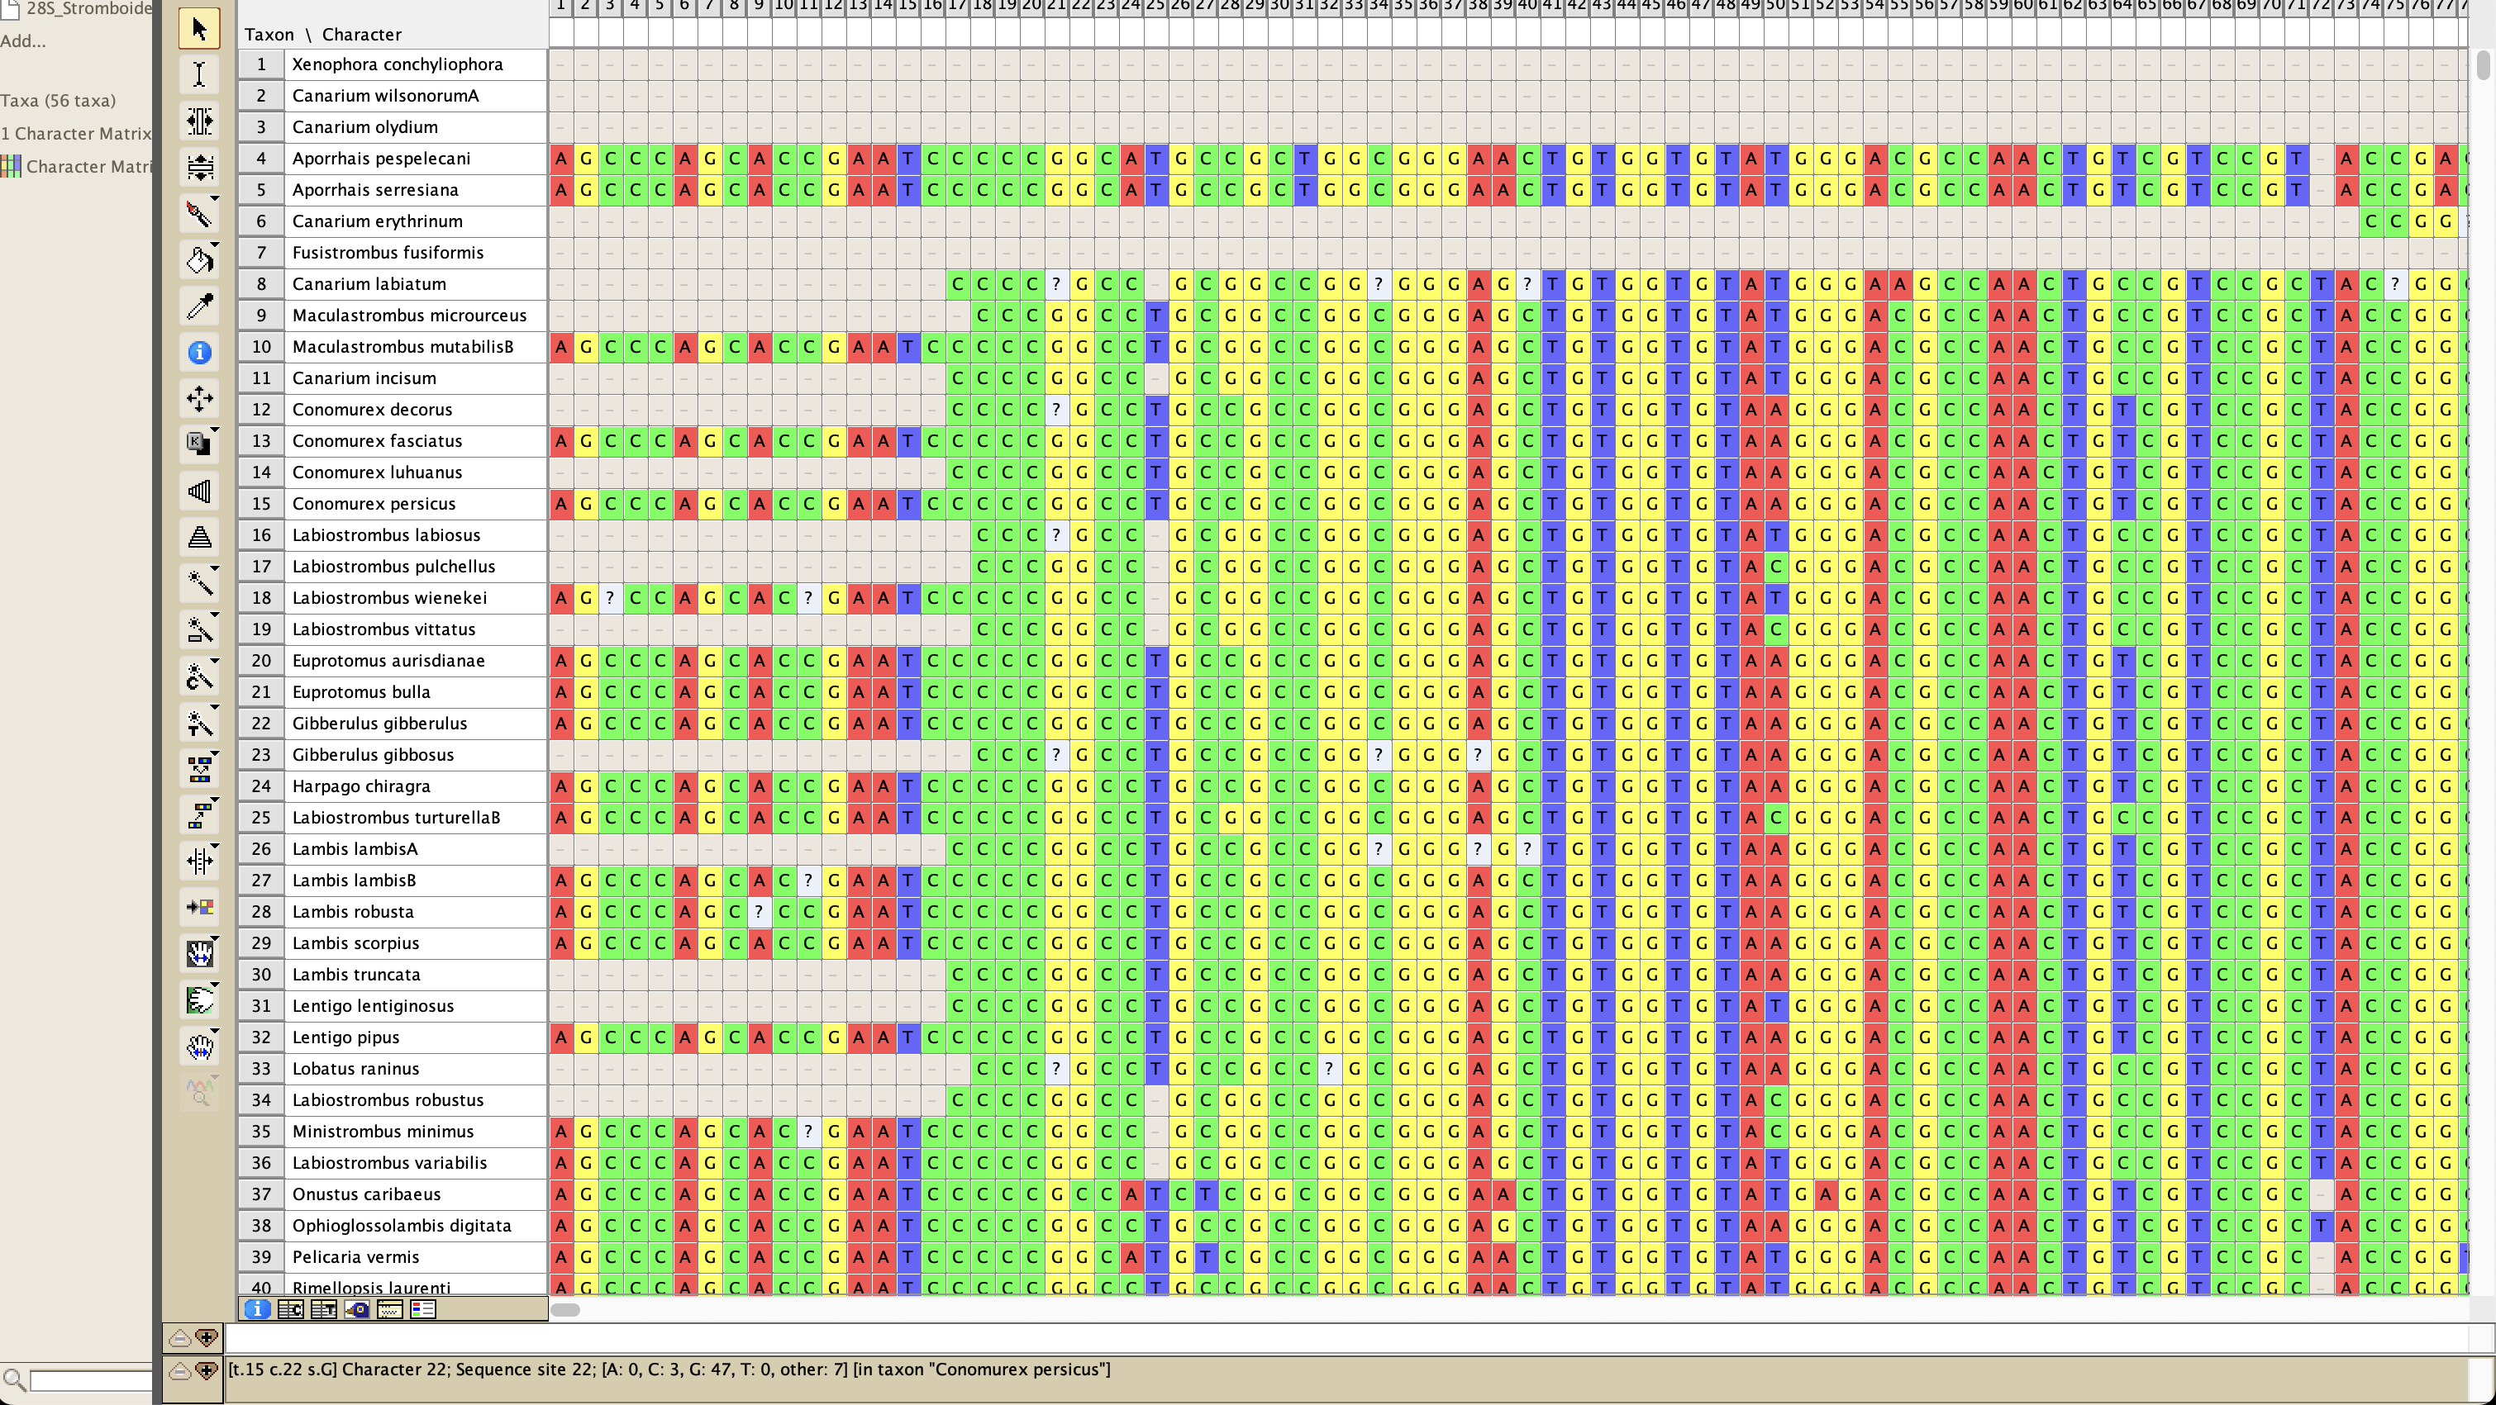

Slide 8
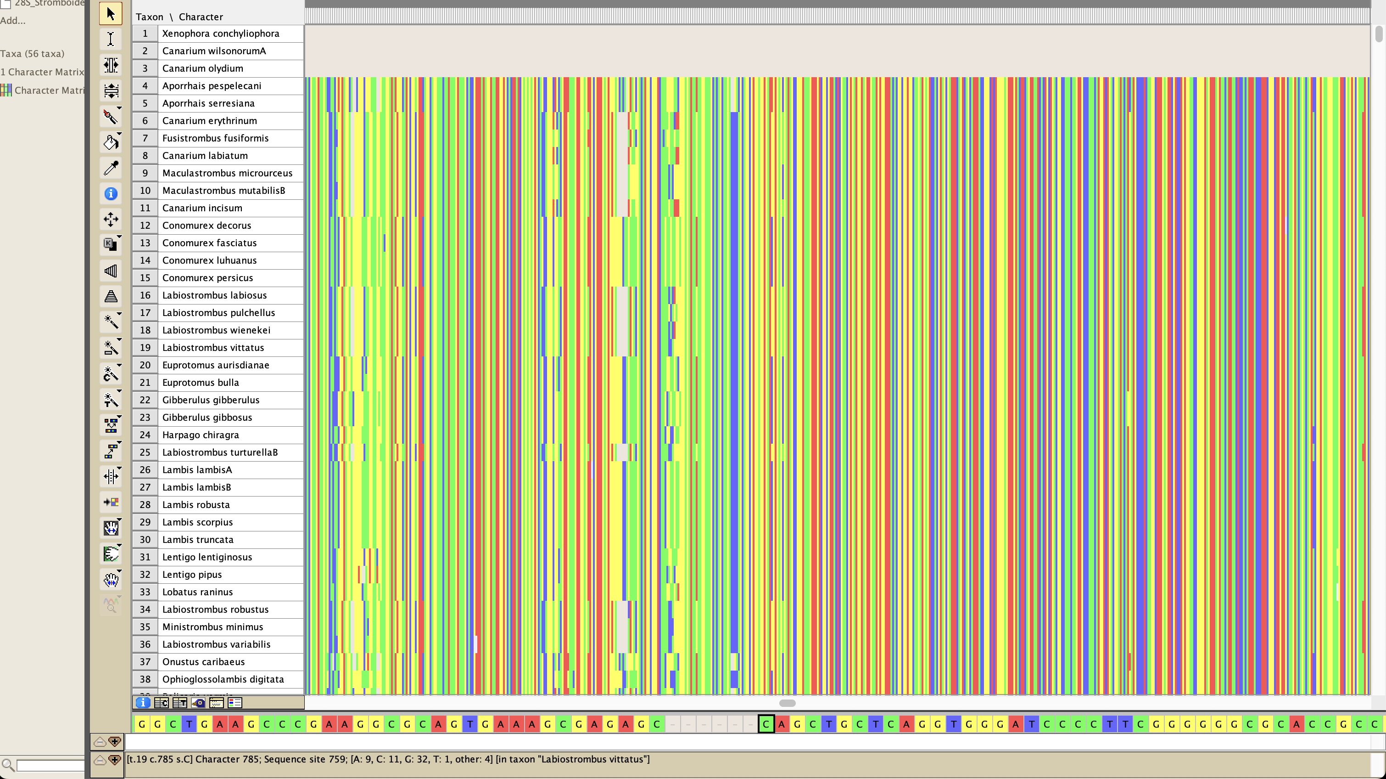

Slide 9
Ribosomal RNA genes were aligned in an iterative process via PASTA (Mirarab et al. 2014), using MAFFT L-INS-i (Katoh et al. 2009) to align, Opal (Wheeler and Kececioglu 2007) to merge adjacent subset alignments pairs, FASTTREE (Price et al. 2009) to estimate a maximum likelihood (ML) tree, GTR + CAT as the nucleotide substitution model, 50% subproblem, and centroid decomposition with 5 iterations and the best alignment determined by likelihood value. Ambiguously aligned regions were excluded via Gblocks 0.91b (Castresana 2000), with smaller final blocks, gap positions within final blocks, and less strict flanking positions allowed; alignment of COI was unambiguous (Supplementary Table S3). Putative editing errors were trimmed from GenBank sequence ends (e.g., COI frameshifting indels).

Slide 10
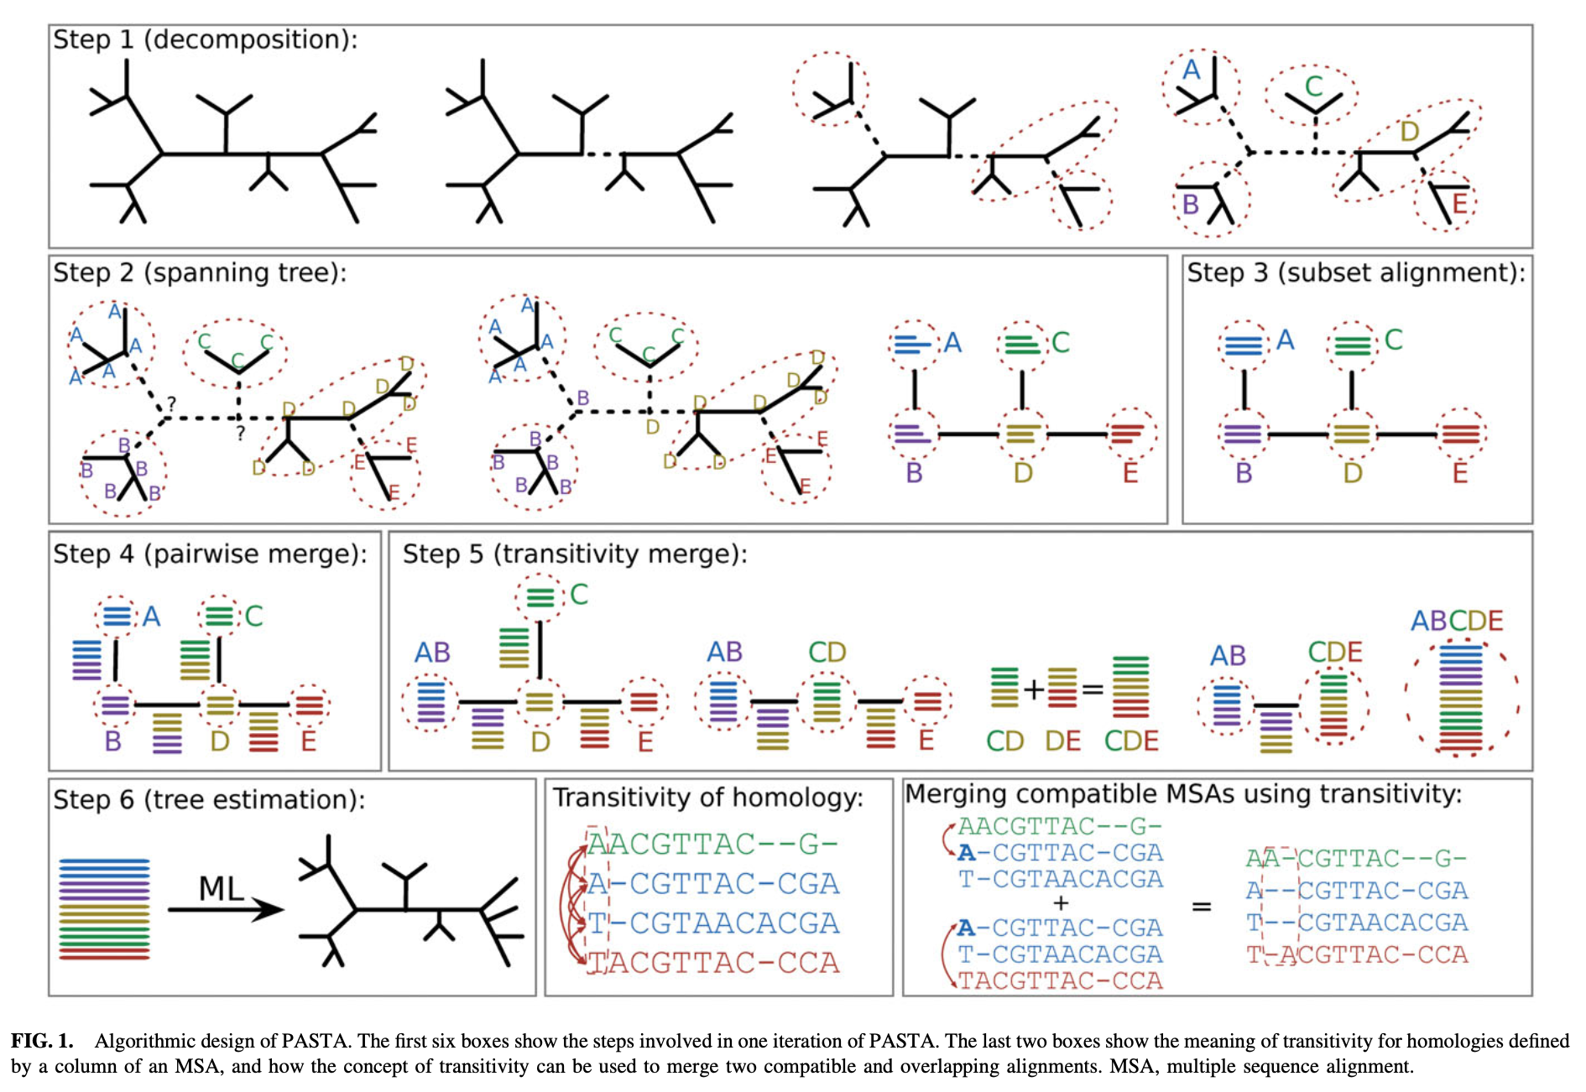
Ribosomal RNA genes were aligned in an iterative process via PASTA (Mirarab et al. 2014), using MAFFT L-INS-i (Katoh et al. 2009) to align, Opal (Wheeler and Kececioglu 2007) to merge adjacent subset alignments pairs, FASTTREE (Price et al. 2009) to estimate a maximum likelihood (ML) tree, GTR + CAT as the nucleotide substitution model, 50% subproblem, and centroid decomposition with 5 iterations and the best alignment determined by likelihood value. Ambiguously aligned regions were excluded via Gblocks 0.91b (Castresana 2000), with smaller final blocks, gap positions within final blocks, and less strict flanking positions allowed; alignment of COI was unambiguous (Supplementary Table S3). Putative editing errors were trimmed from GenBank sequence ends (e.g., COI frameshifting indels).
Figure from Mirarab et al. 2014

Slide 11
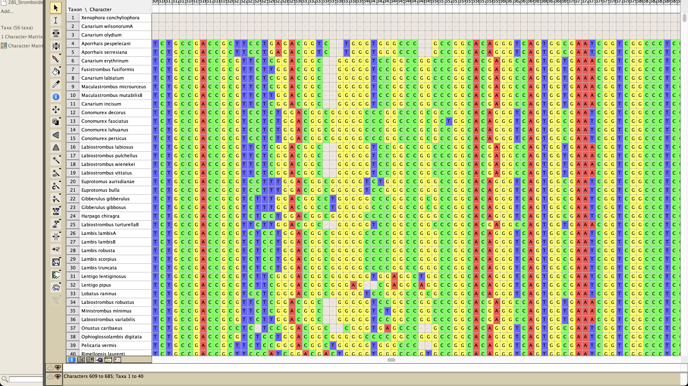

Slide 12
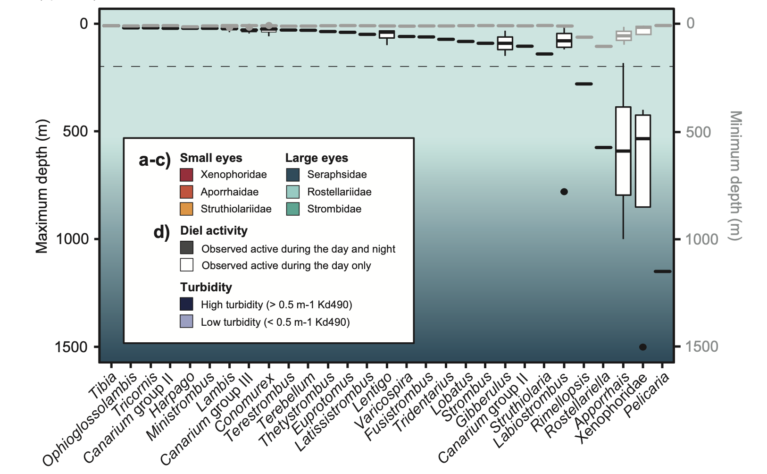

Notes:
One question is are the snails at depths where light matters?

Slide 13
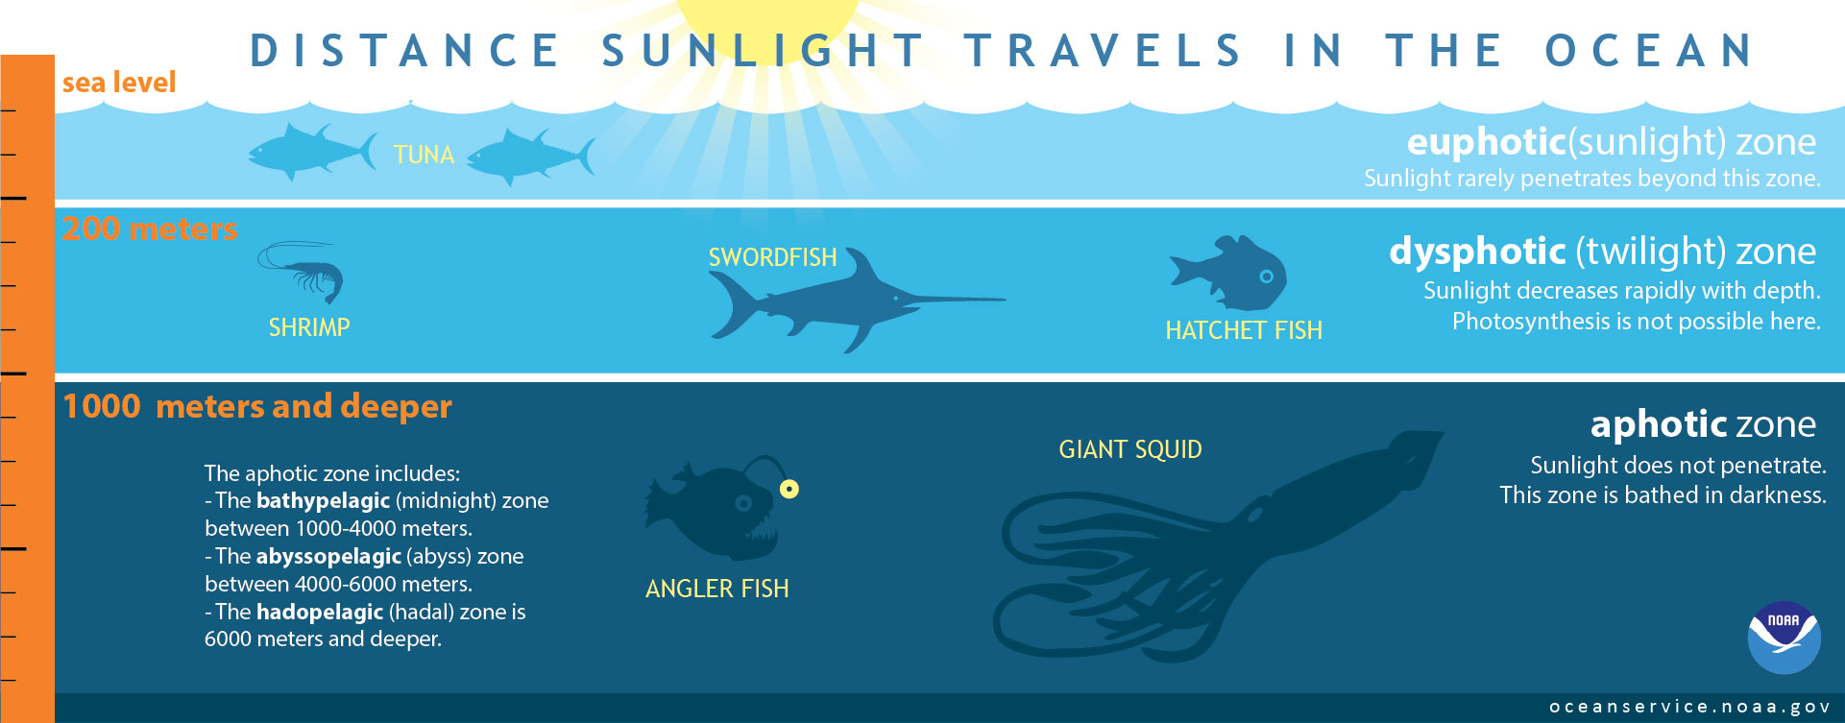
Notes:
And yes, all are in regions where there is light

Slide 14
Tree inference in this paper
Method | Approach | Type | Topology confidence | Used for
*BEAST (“star beast”) | Bayesian | Multi-species coalescent | Posterior probabilities | Create starting tree for BEAST
BEAST | Bayesian | Concatenated | Posterior probabilities | Topology, chronogram, character reconstruction
IQ-TREE | Likelihood | Concatenated | Bootstrap | Topology, character reconstruction
Likelihood: what is the probability of my data given my model (tree, DNA evolution)? Try different model parameters until it’s as good as you can find. “What’s the highest mountain?”
Bayesian: Try to understand the landscape of the likelihood times your prior belief about the models. “What’s the topographic map? Which areas are highest?”

Slide 15
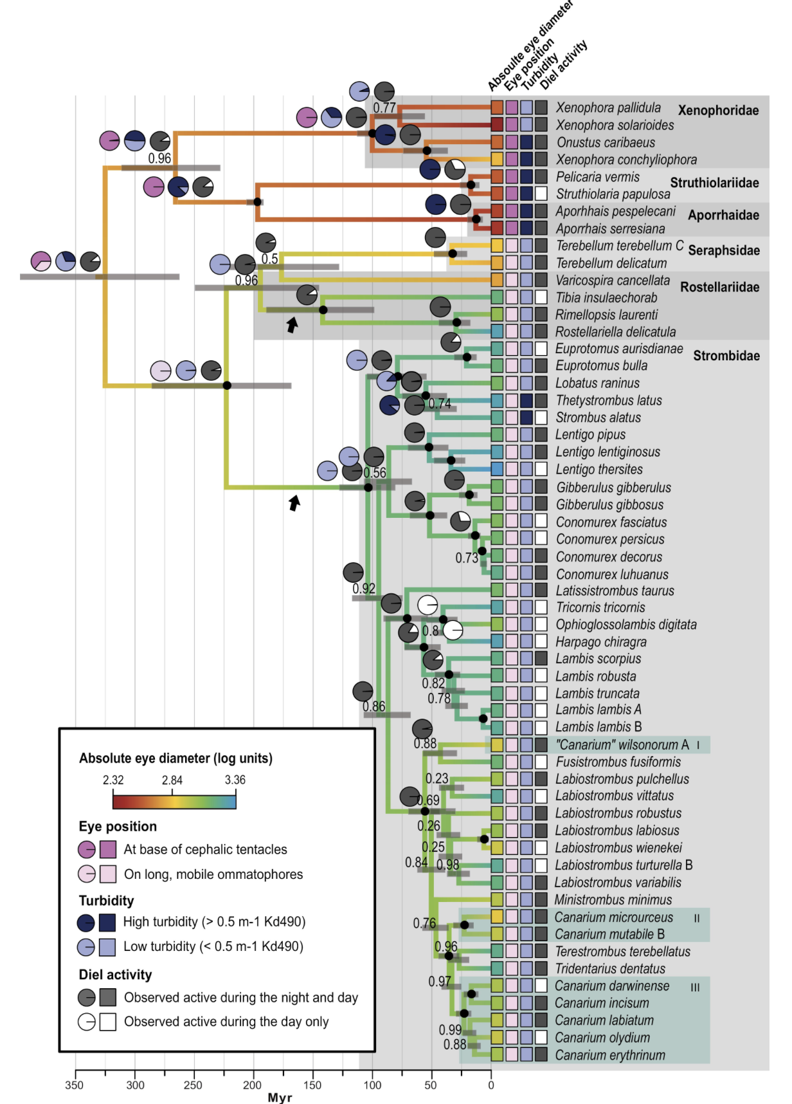
Bayesian analysis of 28S rRNA, COI, 16S rRNA, and 12S rRNA sequences from 56 stromboid species as implemented in BEAST. Branch colors reflect log-transformed absolute eye diameter as reconstructed by ancestral state reconstruction in BEAST (see methods for trait definition). Black arrows mark branches along which eyes increased over 1 mm in diameter. Numbers above branches are PP; black circles at nodes indicate PP = 1.0; gray bars at nodes are 95% HPD intervals for node ages. Turbidity, diel activity, eye position, and eye diameter are indicated for each species at tips by box color (see key). Pie diagrams indicating likely ancestral state reconstruction for discrete traits are shown, corresponding to PP support for each character state; where shallower nodes are identical in root node state to their closest ancestor, pie diagrams are removed for ease of reading. For the purposes of generic- or clade-level statistical analyses, generic boundaries were adjusted according to the BEAST analysis results to prevent treating non-monophyletic genera as a clade; note use of the term “Canarium groups I–III” (marked as I–III in boxes drawn around corresponding clades) for ease of discussion and for analyses by stromboid genera or clade

Slide 16
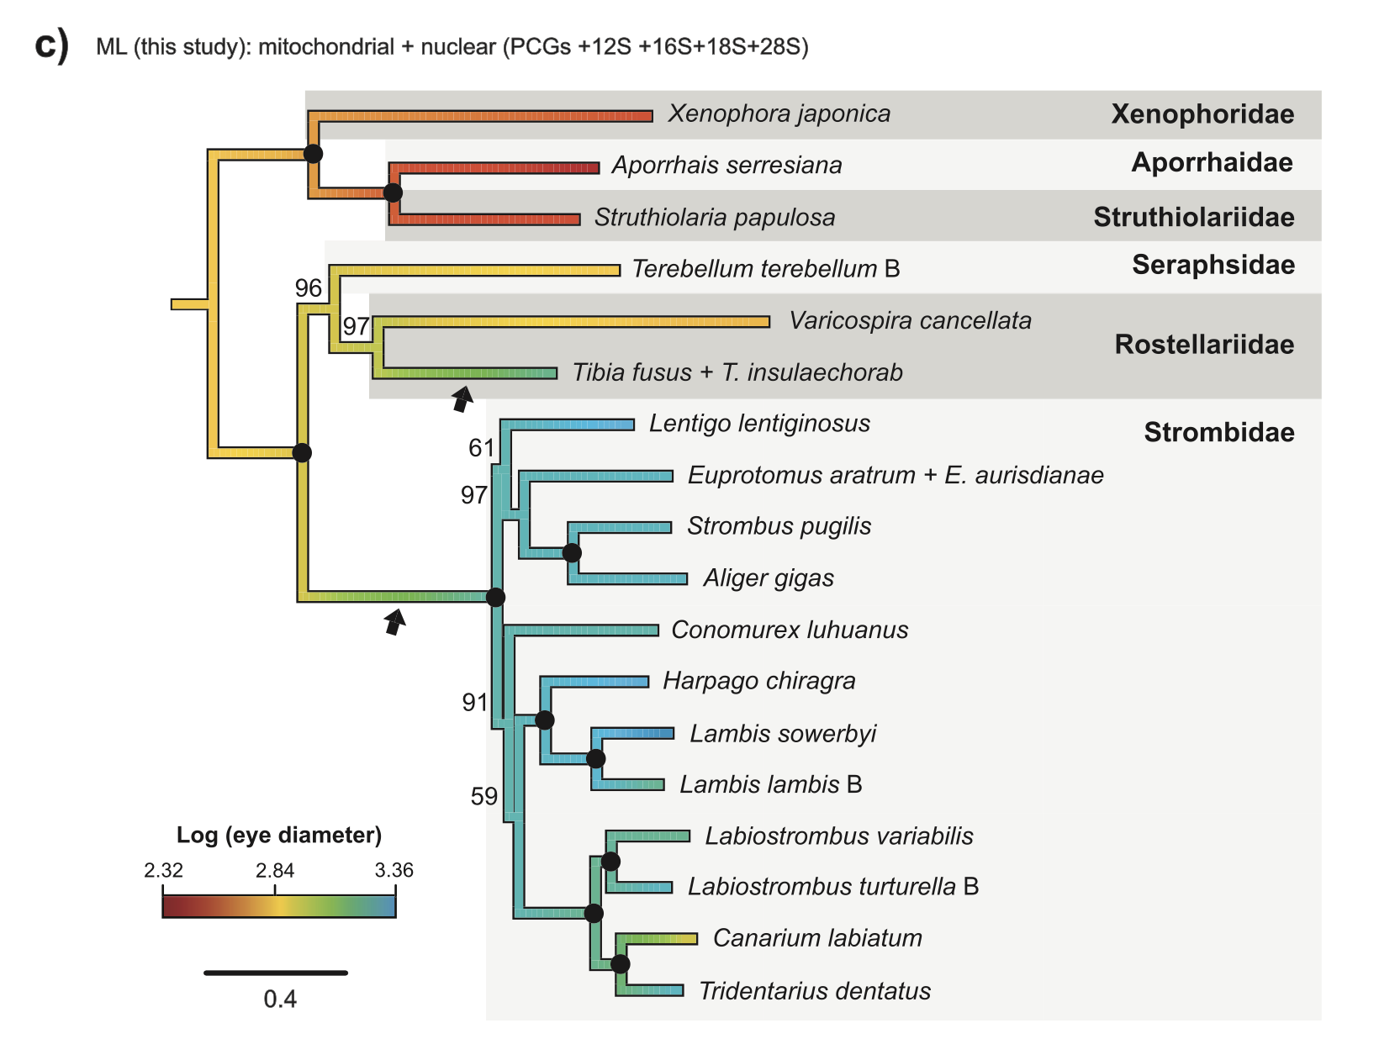
Relationships among stromboid families. …
(c) ML analysis of 15 mitochondrial genes (13 protein-coding genes (mtPCGs), 12S rRNA and 16S rRNA) and 2 nuclear genes (18S rRNA and 28S rRNA) via IQ-TREE. Branch colors reflect log-transformed absolute eye diameter as reconstructed by ancestral state reconstruction in R (see methods for trait definition). Black arrows mark branches along which eyes increased over 1 mm in diameter in the large-eyed clade. Numbers above branches are ML ultrafast bootstrap values; black circles at nodes indicate BS = 100. Outgroup is removed for ease of reading

Slide 17
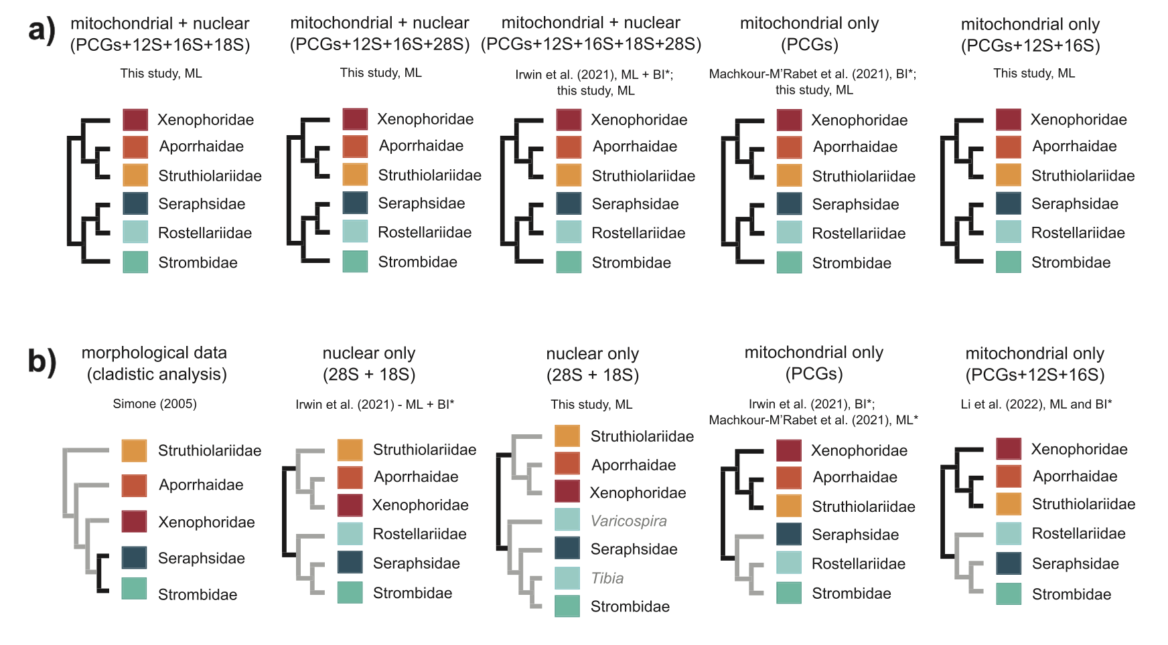
Relationships among stromboid families. A summary of all stromboid topologies recovered in this and prior studies (morphological or molecular analyses), with (a) topologies consistent with both this study and Irwin et al. (2021) and (b) inconsistent topologies, with incongruent branches marked in gray. Asterisk (*) indicates where only Varicospira is included as a representative of Rostellariidae in analyses; where the monophyly of Rostellariidae is not recovered, genus names are given in gray.
Notes:
PCG=protein coding genes

Slide 18
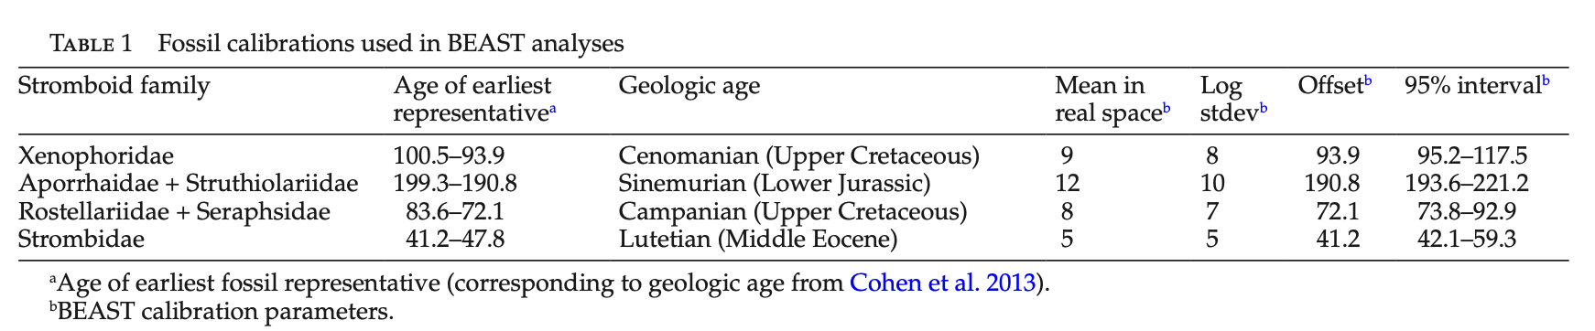

Slide 19
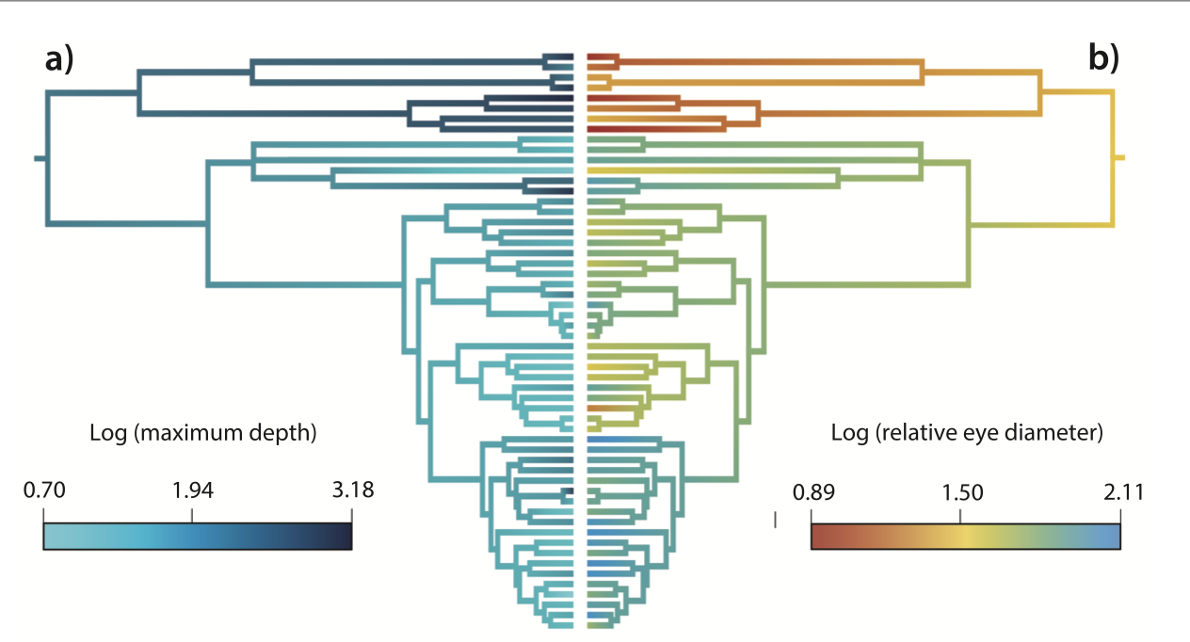
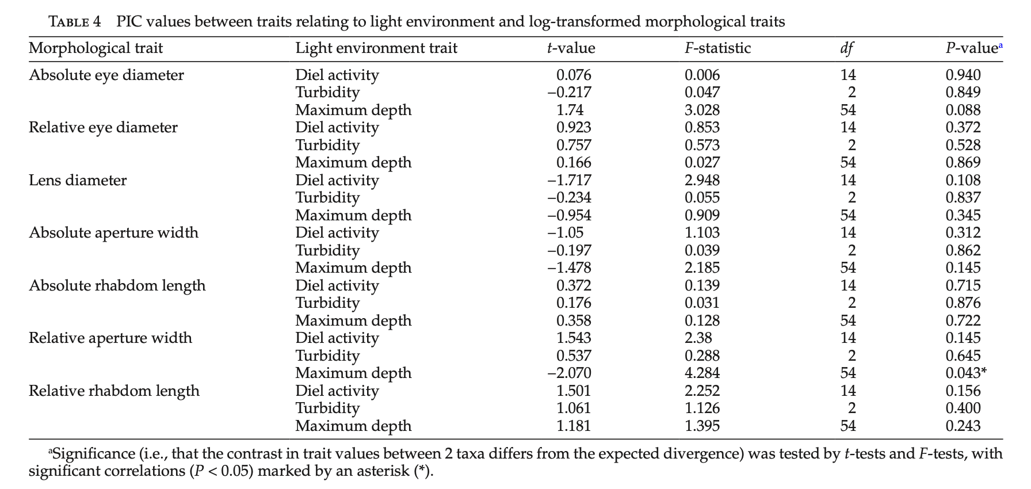

Slide 20
1 of 21 tests with uncorrected P-values were significant (0.043)

Slide 21
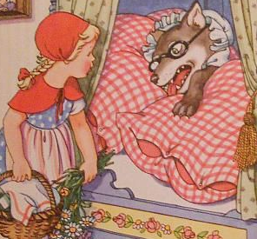
Discussion prompts
What questions do you have about the data used to build the tree?
Questions about alignment?
Questions about the phylogeny inference itself?
What were the utility / risks of:
Looking at phylogenetic signal?
Looking at the ancestral state reconstructions?
Looking at independent contrasts?
Looking at raw comparisons?
Did this convince you that big eyes are an anti-predator defense? Why or why not?
How would this change with the same degree of evidence but with less plausible hypotheses? i.e., ”Big eyes evolved to whirl around and stir up sediments in deeper waters”
If this were your research system, what would you do next?
“Grandma, what big eyes you have” ”The better to see you with, my dear”
[No spandrels in folktale cottages]

